Slide 1
IPL AUCTION
Developing auction strategy for new IPL franchise by analyzing past IPL data to create a strong and balanced squad
Submitted by - Nupoor Bari
Course - Data Science
SQL Project

Slide 2
Auction Plan
Players
Batters
Aggressive Batters
Anchor Batters
Bowlers
Economical Bowlers
All- rounders
Hard-Hitters
Wicket-taking Bowlers
Wicketkeepers

Slide 3
Query for creating table ‘Deliveries’ from IPL_Ball data
create table Deliveries(
id int, inning int, over int, ball int, batsman varchar, non_striker varchar,
bowler varchar, batsman_runs int, extra_runs int, total_runs int, is_wicket int,
dismissed_kind varchar, player_dismissed varchar, fielder varchar,
extras_type varchar, batting_team varchar, bowling_team varchar);
copy deliveries from 'C:\Program Files\PostgreSQL\15\data\Data_Copy\IPL_Ball.csv' delimiter ',' csv header;

Slide 4
Query for creating table ‘Matches’ from IPL_matches data
create table Matches (
id int, city varchar, date date, player_of_the_match varchar, venue varchar,
neutral_venue int, team_1 varchar, team_2 varchar, toss_winner varchar,
toss_decision varchar, winner varchar, result varchar, result_margin int,
eliminator varchar, method varchar, umpire_1 varchar, umpire_2 varchar);
copy matches from 'C:\Program Files\PostgreSQL\15\data\Data_Copy\IPL_matches.csv' delimiter ',' csv header;

Slide 5
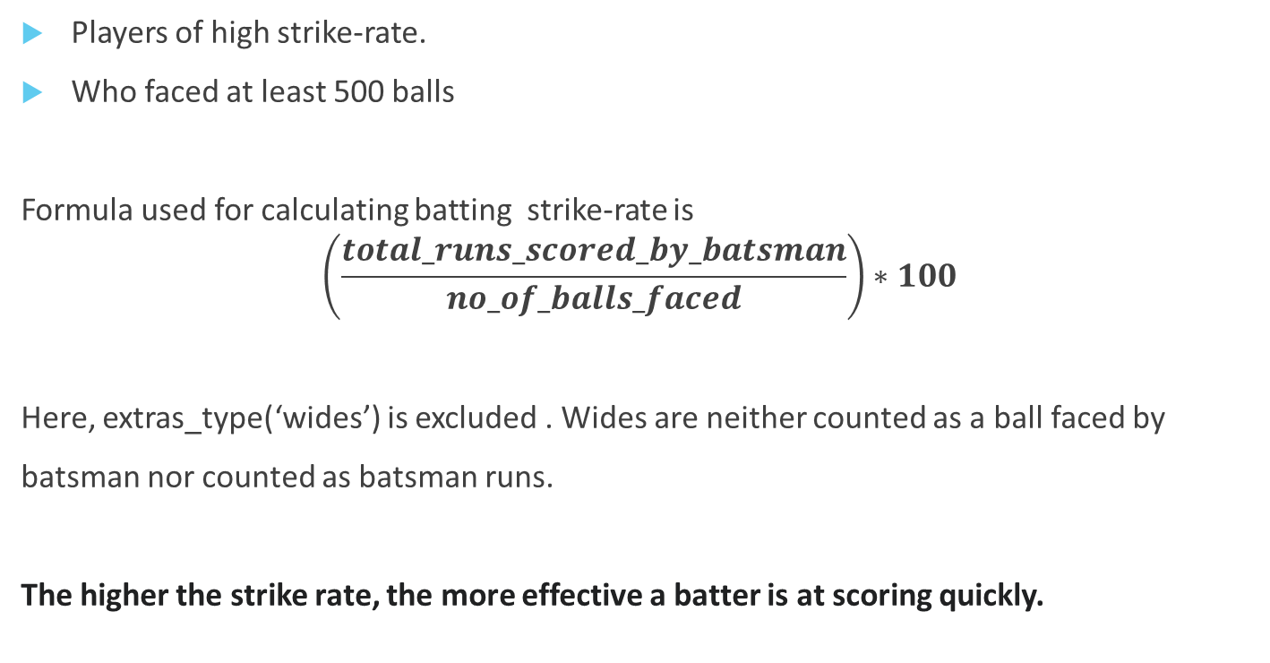
Criteria for Aggressive Batters
Players of high strike-rate.
Who faced at least 500 balls
Formula used for calculating batting strike-rate is
$$\left(\frac{total_runs_scored_by_batsman}{no_of_balls_faced}\right)∗100$$
Here, extras_type(‘wides’) is excluded . Wides are neither counted as a ball faced by
batsman nor counted as batsman runs.
The higher the strike rate, the more effective a batter is at scoring quickly.

Slide 6
Query for Aggressive Batters
select batsman, sum(batsman_runs) as total_runs_scored, count(ball) as no_of_balls_faced,
round(sum(batsman_runs)*1.0/count(ball) * 100 ,2)
as strike_rate
from deliveries
where extras_type <> 'wides'
group by batsman
having count(ball) >= 500
order by strike_rate desc
limit 10;

Slide 7
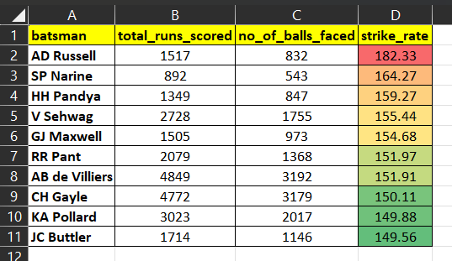
List of Aggressive Batters

Slide 8
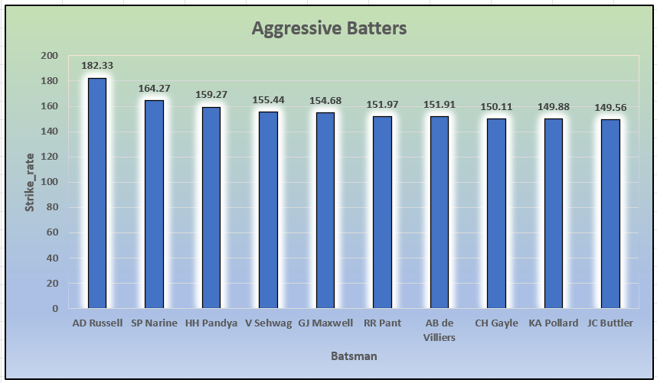

Slide 9
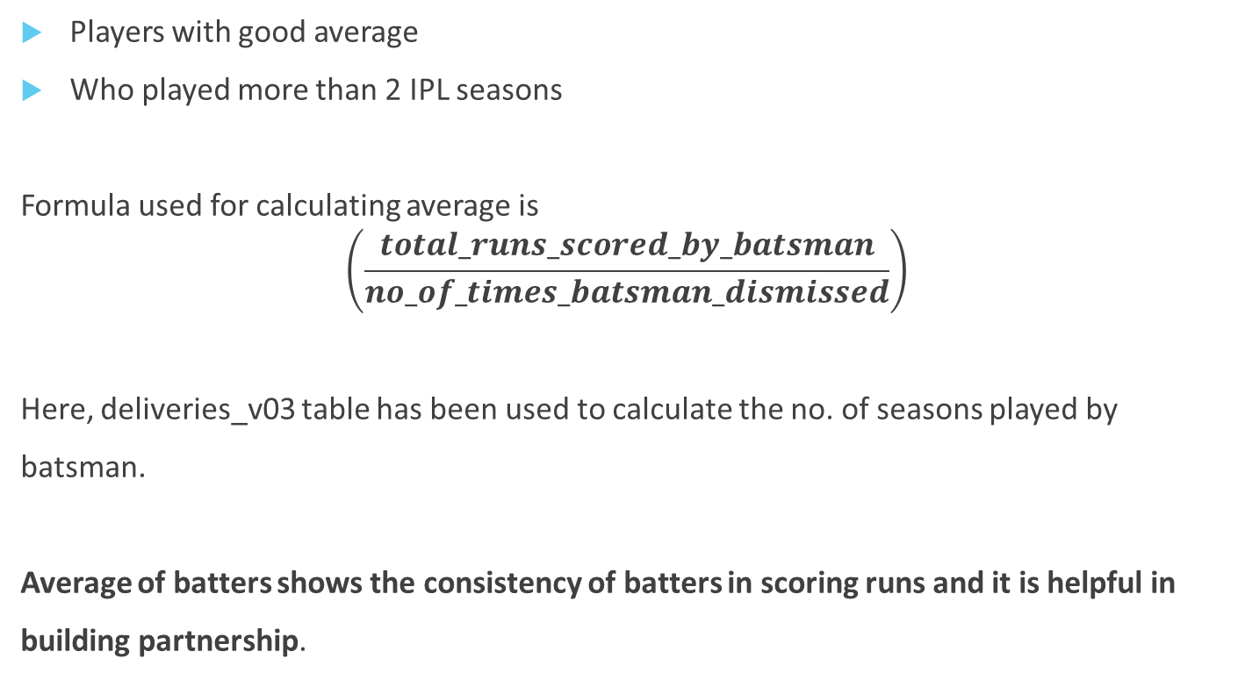
Criteria for Anchor Batters
Players with good average
Who played more than 2 IPL seasons
Formula used for calculating average is
$$\left(\frac{total_runs_scored_by_batsman}{no_of_times_batsman_dismissed}\right)$$
Here, deliveries_v03 table has been used to calculate the no. of seasons played by
batsman.
Average of batters shows the consistency of batters in scoring runs and it is helpful in
building partnership.

Slide 10
Query for Anchor Batters
select batsman, sum(batsman_runs) as total_runs_scored,
sum(is_wicket) as no_of_times_dismissed,
count(distinct extract (year from match_date)) as season_played,
round((sum(batsman_runs) * 1.0 /sum(is_wicket)),2) as Average
from deliveries_v03
group by batsman
having sum(is_wicket) >=1 and count(distinct extract(year from match_date)) > 2
order by average desc
limit 10;

Slide 11
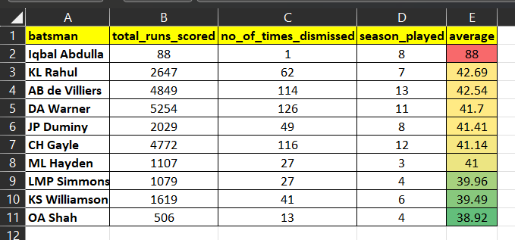
List of Anchor Batters
Here, we can take Iqbal Abdulla as an exception because although he had played 8 ipl season but he dismissed only 1 time therefore, his average is higher as compared to the other batsman.

Slide 12
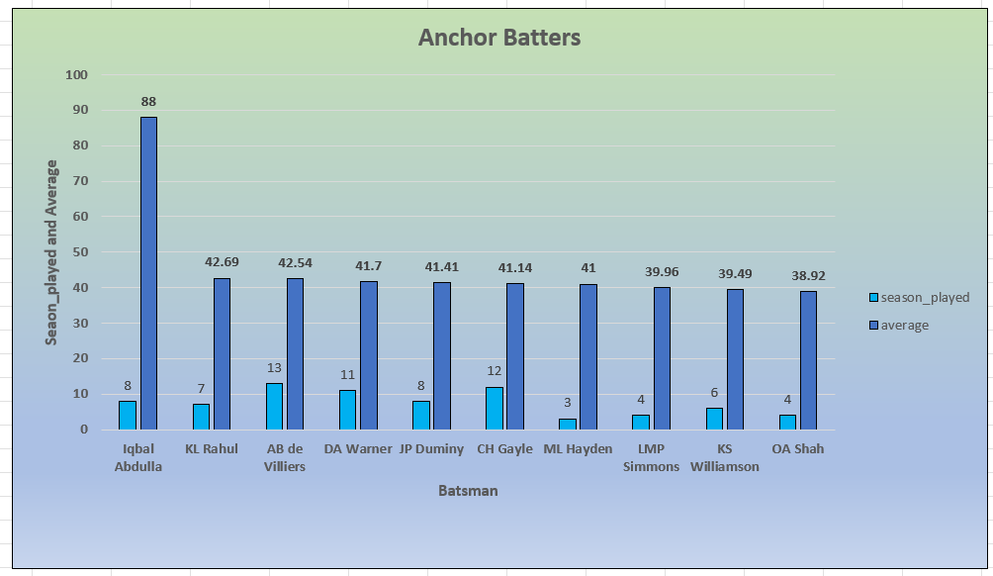

Slide 13
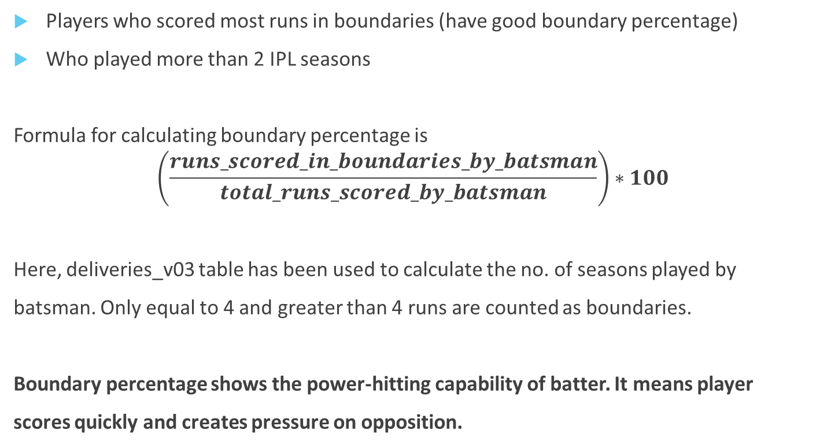
Criteria for Hard-Hitters
Players who scored most runs in boundaries (have good boundary percentage)
Who played more than 2 IPL seasons
Formula for calculating boundary percentage is
$$\left(\frac{runs_scored_in_boundaries_by_batsman}{total_runs_scored_by_batsman}\right)∗100$$
Here, deliveries_v03 table has been used to calculate the no. of seasons played by
batsman. Only equal to 4 and greater than 4 runs are counted as boundaries.
Boundary percentage shows the power-hitting capability of batter. It means player
scores quickly and creates pressure on opposition.

Slide 14
Query for Hard-Hitters
select a.batsman,
count(distinct extract(year from match_date)) as season_played,
b.total_boundaries,
b.boundary_total,
sum(a.batsman_runs) as total_runs,
round(((b.boundary_total)*1.0 / sum(a.batsman_runs))*100,2) as boundary_percentage
from deliveries_v03 as a
join (select batsman, count(batsman_runs) as total_boundaries, sum(batsman_runs) as boundary_total
from deliveries_v03 where batsman_runs >= 4 group by batsman ) as b
on a.batsman = b.batsman
group by a.batsman, b.total_boundaries, b.boundary_total
having count(distinct extract(year from match_date)) > 2
order by boundary_percentage desc
limit 10;

Slide 15
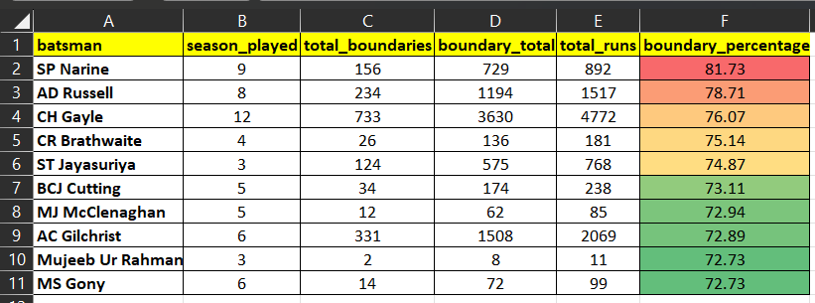
List of Hard-hitters

Slide 16
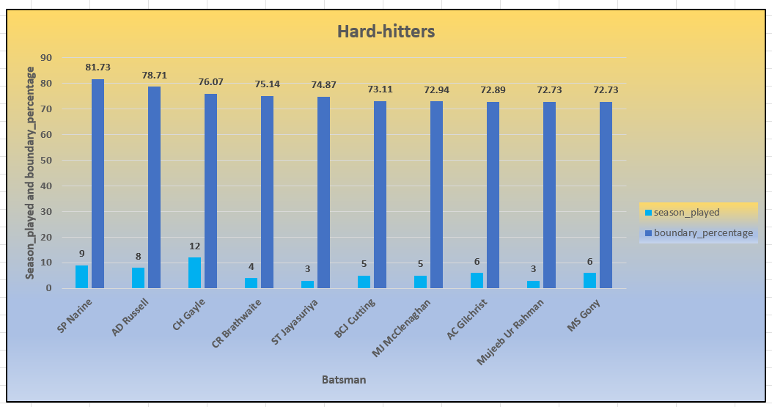

Slide 17
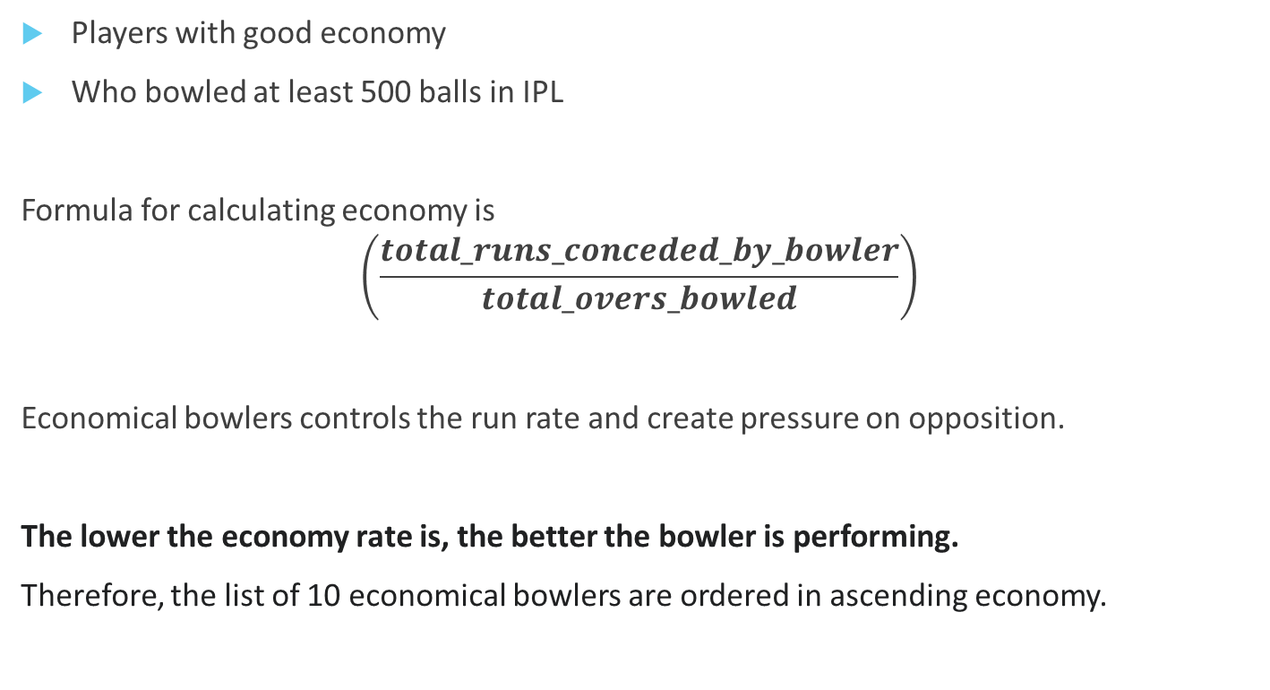
Criteria for Economical Bowlers
Players with good economy
Who bowled at least 500 balls in IPL
Formula for calculating economy is
$$\left(\frac{total_runs_conceded_by_bowler}{total_overs_bowled}\right)$$
Economical bowlers controls the run rate and create pressure on opposition.
The lower the economy rate is, the better the bowler is performing.
Therefore, the list of 10 economical bowlers are ordered in ascending economy.

Slide 18
Query for Economical Bowlers
select bowler,
count(ball) as no_of_balls_bowled,
round((sum(total_runs)/(count(ball)/6.0)),2) as economy
from deliveries group by bowler
having count(ball) >= 500
order by economy asc
limit 10;

Slide 19
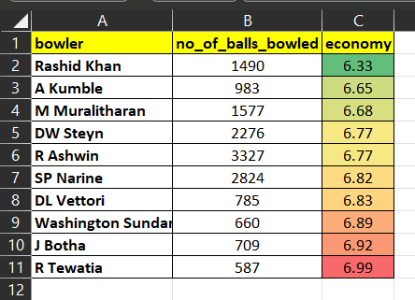
List of Economical Bowlers

Slide 20
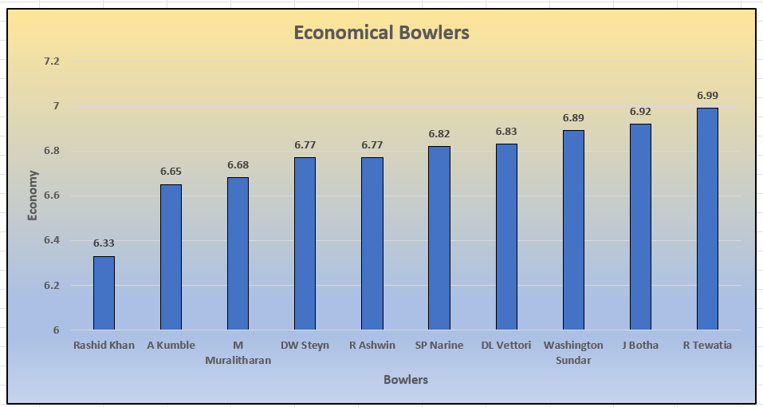

Slide 21
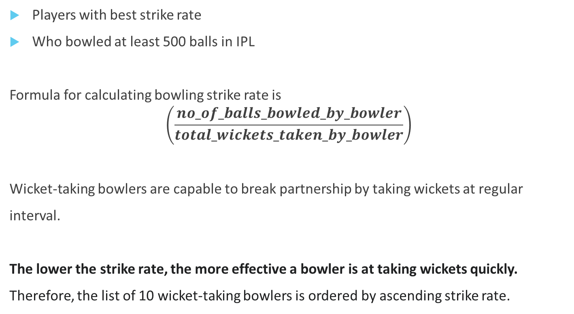
Criteria for Wicket-taking Bowlers
Players with best strike rate
Who bowled at least 500 balls in IPL
Formula for calculating bowling strike rate is
$$\left(\frac{no_of_balls_bowled_by_bowler}{total_wickets_taken_by_bowler}\right)$$
Wicket-taking bowlers are capable to break partnership by taking wickets at regular
interval.
The lower the strike rate, the more effective a bowler is at taking wickets quickly.
Therefore, the list of 10 wicket-taking bowlers is ordered by ascending strike rate.

Slide 22
Query for Wicket-taking Bowlers
select bowler, count(ball) as no_of_balls_bowled,
round((count(ball)*1.0/sum(is_wicket)),2) as strike_rate
from deliveries
group by bowler
having count(ball) >= 500
order by strike_rate
limit 10;

Slide 23
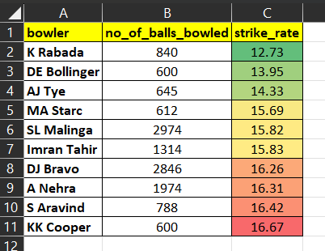
List of Wicket-taking Bowlers

Slide 24
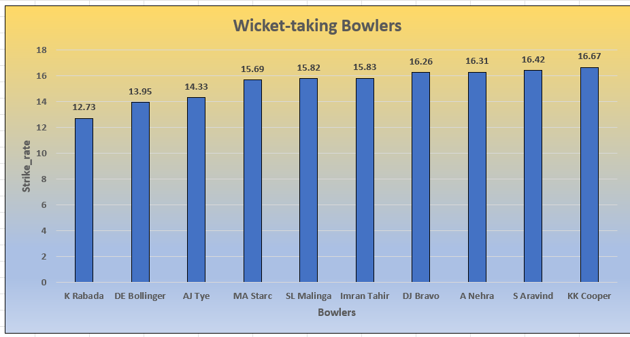

Slide 25
Criteria for All-Rounders
Players with best batting strike rate and bowling strike rate
Who faced at least 500 balls in IPL
Who bowled minimum 300 balls in IPL
All-Rounders score runs quickly and bowl in powerplay, middle overs and in death overs also. They provide flexibility and variety of deliveries.
As we know the higher batting strike rate shows the better performance of batter and lowest bowling strike rate shows the better performance of bowler.
Therefore the list of 10 all-rounders are ordered in descending batting strike rate and ascending bowling strike rate.

Slide 26
Query for All-Rounders
select batsman as all_rounder, count(ball) as no_of_balls_faced, b.no_of_balls_bowled,
b.bowling_sr,
round((sum(batsman_runs)*1.0/ count(ball)),2) * 100 as batting_sr from deliveries as a
inner join (select bowler, count(ball) as no_of_balls_bowled,
round((count(ball)*1.0/sum(is_wicket)),2) as bowling_sr from deliveries
group by bowler
having count(ball) >=300
) as b
on a.batsman = b.bowler
where extras_type <>'wide'
group by batsman, bowling_sr, no_of_balls_bowled
having count(ball) >= 500
order by batting_sr desc, bowling_sr asc
limit 10;

Slide 27
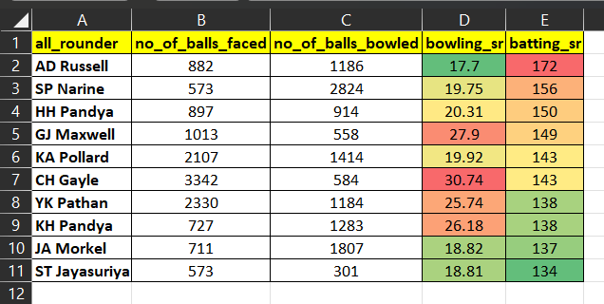
List of All-Rounders

Slide 28
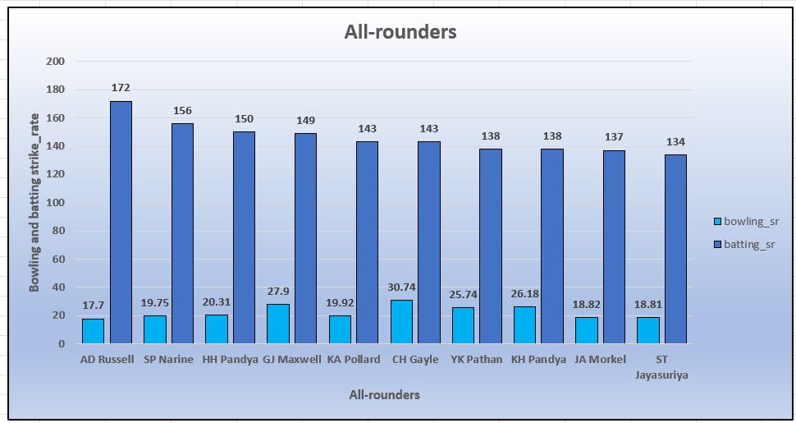

Slide 29
Criteria for Wicketkeepers
The role of wicketkeepers are slightly different from other players in cricket. However, the wicketkeeper contributes a lot in the game. Wicketkeeper should be the player
With good fielding and stumping skills
With good knowledge of field placement as he is in the centre of the field
With good physique as the wicketkeeper mostly in squat position during the game
With good side bouncing capability to catch the ball
Besides, all of the hard skills the wicketkeeper needs a soft skills like
Alertness of mind
Sharp eye on ball and stumps
Good reflex action as it comes from practice
Wicketkeeper can advice the bowler as he is nearest to the batter
The role of wicketkeeper is like a game changer as he is important to run out the batsman which creates the pressure on opponents.

Slide 30
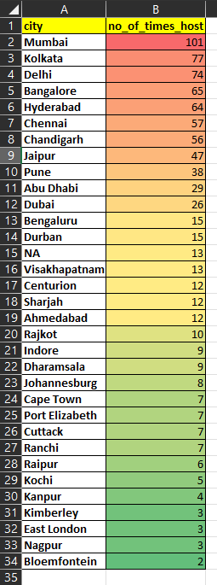
Additional Questions for Final Assessment
1. Get the count of cities that have hosted an IPL match
select count(distinct city) as no_of_cities from matches; --33
select city, count(city) as no_of_times_host
from matches
group by city
order by no_of_times_host desc ;

Slide 31
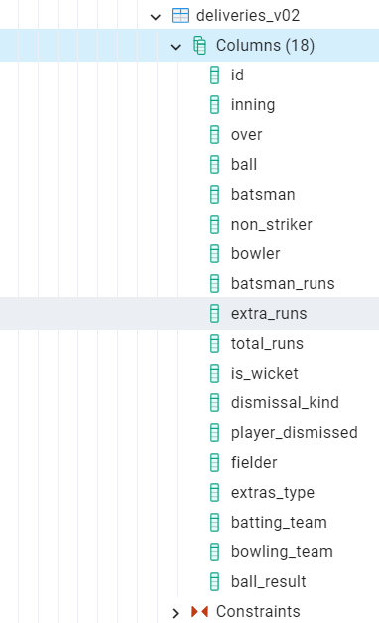
2. Create table deliveries_v02 with all the columns of the table ‘deliveries’ and an additional column ball_result containing values boundary, dot or other depending on the total_run (boundary for >= 4, dot for 0 and other for any other number)
(Hint 1 : CASE WHEN statement is used to get condition based results) (Hint 2: To convert the output data of the select statement into a table, you can use a subquery. Create table table_name as [entire select statement].
create table deliveries_v02 as (select * ,
case when
total_runs >=4 then 'boundary'
when total_runs =0 then 'dot'
else 'other'
end as ball_result
from deliveries);

Slide 32
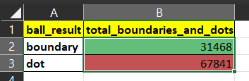
3. Write a query to fetch the total number of boundaries and dot balls from the deliveries_v02 table.
select ball_result, count(ball_result) as total_boundaries_and_dots from
deliveries_v02
where ball_result = 'boundary' or ball_result = 'dot' group by ball_result;

Slide 33
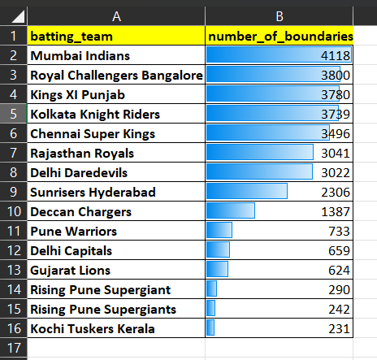
4. Write a query to fetch the total number of boundaries scored by each team from the deliveries_v02 table and order it in descending order of the number of boundaries scored.
Select batting_team, count(ball_result) as number_of_boundaries
from deliveries_v02
where ball_result = 'boundary'
group by batting_team
order by number_of_boundaries desc;

Slide 34
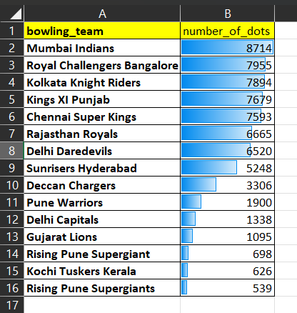
5. Write a query to fetch the total number of dot balls bowled by each team and order it in descending order of the total number of dot balls bowled.
Select bowling_team, count(ball_result) as number_of_dots
from deliveries_v02
where ball_result = 'dot' and bowling_team <> 'NA'
group by bowling_team
order by number_of_dots desc;

Slide 35
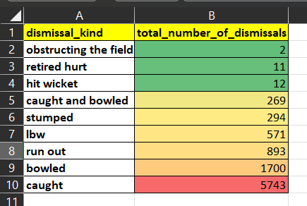
6. Write a query to fetch the total number of dismissals by dismissal kinds where dismissal kind is not NA
select dismissal_kind, count(dismissal_kind) as total_number_of_dismissals from
deliveries_v02
where dismissal_kind <> 'NA'
group by dismissal_kind
order by total_number_of_dismissals;

Slide 36
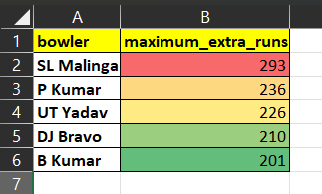
7. Write a query to get the top 5 bowlers who conceded maximum extra runs from the deliveries table
Select bowler,
sum(extra_runs) as maximum_extra_runs from deliveries
Where extra_runs <> 0
Group by bowler
order by maximum_extra_runs desc
Limit 5;

Slide 37
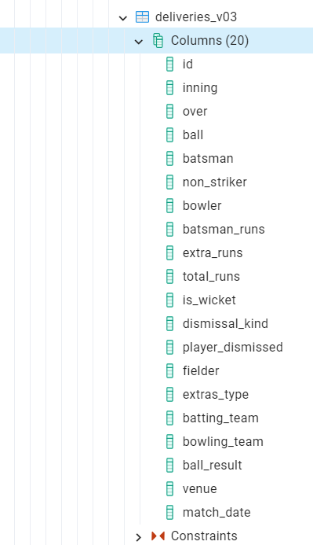
8. Write a query to create a table named deliveries_v03 with all the columns of deliveries_v02 table and two additional column (named venue and match_date) of venue and date from table matches
create table deliveries_v03 as
( select a.*, b.venue, b.match_date
from deliveries_v02 as a
join(select id, venue, date as match_date from matches) as b
on a.id = b.id);

Slide 38
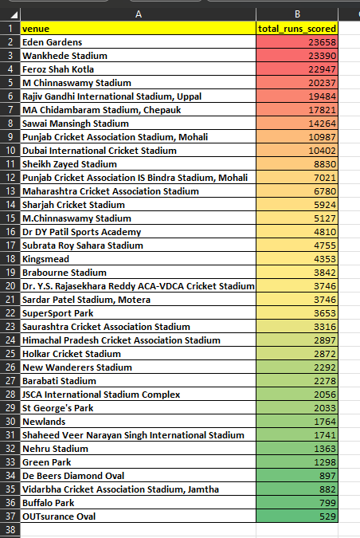
9. Write a query to fetch the total runs scored for each venue and order it in the descending order of total runs scored.
select venue,
sum(total_runs) as total_runs_scored from deliveries_v03
group by venue
order by total_runs_scored desc;

Slide 39
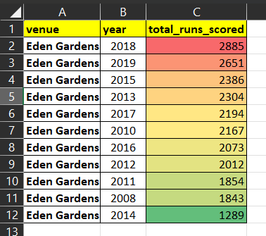
10. Write a query to fetch the year-wise total runs scored at Eden Gardens and order it in the descending order of total runs scored.
select venue,
extract(year from match_date) as year,
sum(total_runs) as total_runs_scored
from deliveries_v03
where venue = 'Eden Gardens'
group by venue, year
order by total_runs_scored desc;

Slide 40
Thank You

